Slide 1
CASE STUDY EXPLORATORY DATA ANALYSIS OF GOLD ATLANTIS FIRM: IDENTIFYING DEFAULTING CUSTOMERS
Mentored by – Jaya Pandey
Presented By- Pushkar Hedau

Slide 2
Introduction
Gold atlantis is a credit providing firm , observed a rise in the number of defaulters. The firm is interested in finding those customers who have lower probability of becoming a defaulter. As an analyst you need to analyse the credit data of gold atlantis and figure out various patterns in the data and make interpretations.

Slide 3
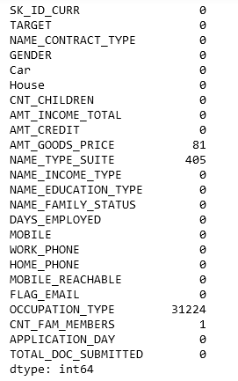
Level Zero : Understanding Data
Inspect
Visually inspect the first few and last few rows of the data.
Check
Check the shape of the data frame.
Check
Check the count of null values in each column.
Inspect
Inspect all the column names and cross check with the data dictionary.
Check
Check the information of the data frame using the info() function.

Slide 4
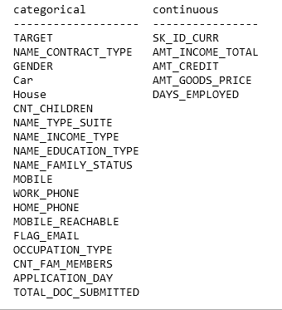
Level One : Univariate analysis

Slide 5
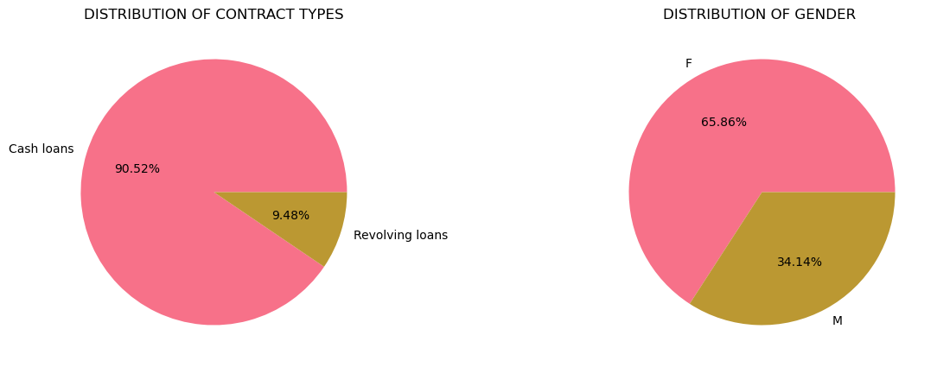
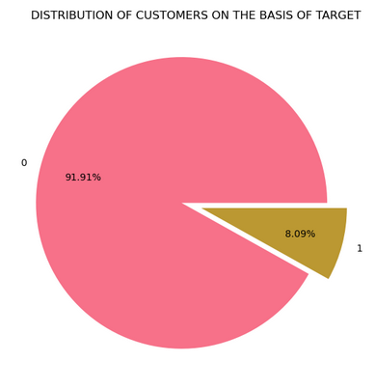
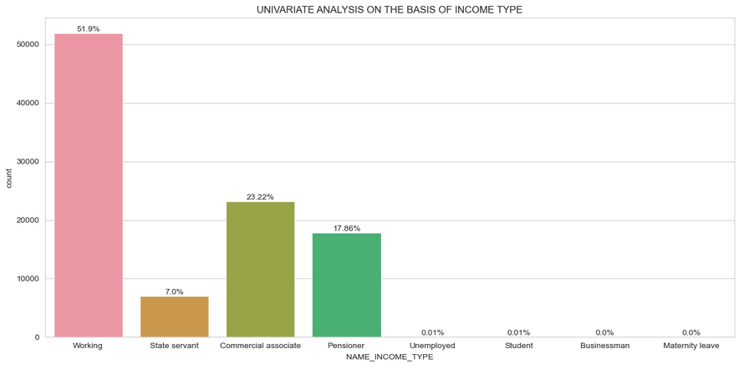
UNIVARIATE ANALYSIS OF CATEGORICAL COLUMNS
INTERPRETATION--
There are less number of revolving loans as compared to cash loans.
More number females ie 65% than males 35% .
On the basis of income type , working type are in majority then commercial associate, and pensioners and state govt.
Unemployed, student , businessman, maternity leave are very nominal .

Slide 6
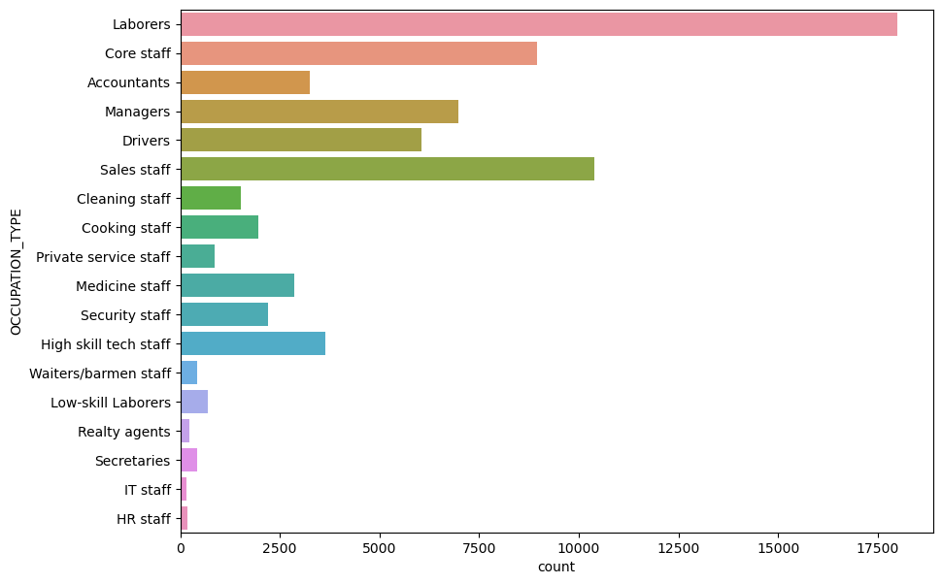
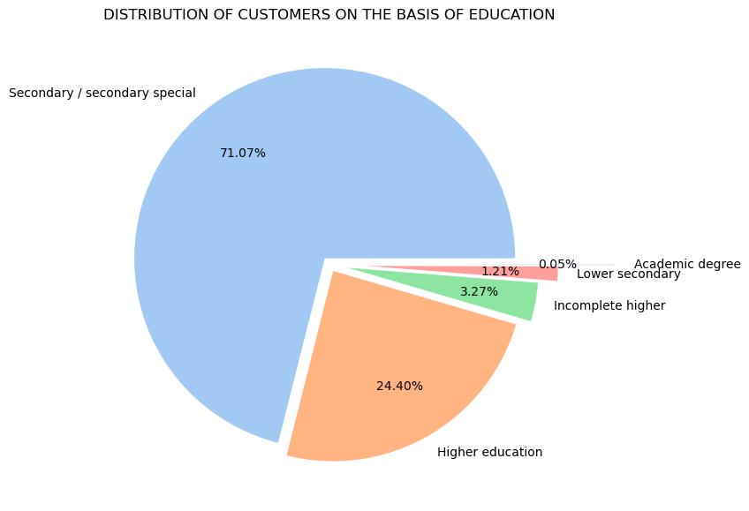
UNIVARIATE ANALYSIS OF CATEGORICAL COLUMNS
Interpretation--
Labourers are maximum in numbers , then sales, core staff, managers and drivers.
People from IT staff, HR staff, secretaries, reality agents are the least.
Mostly people have secondary education at 71%., then higher education at 24 %
People with academic education and lower education is l very least in number.

Slide 7
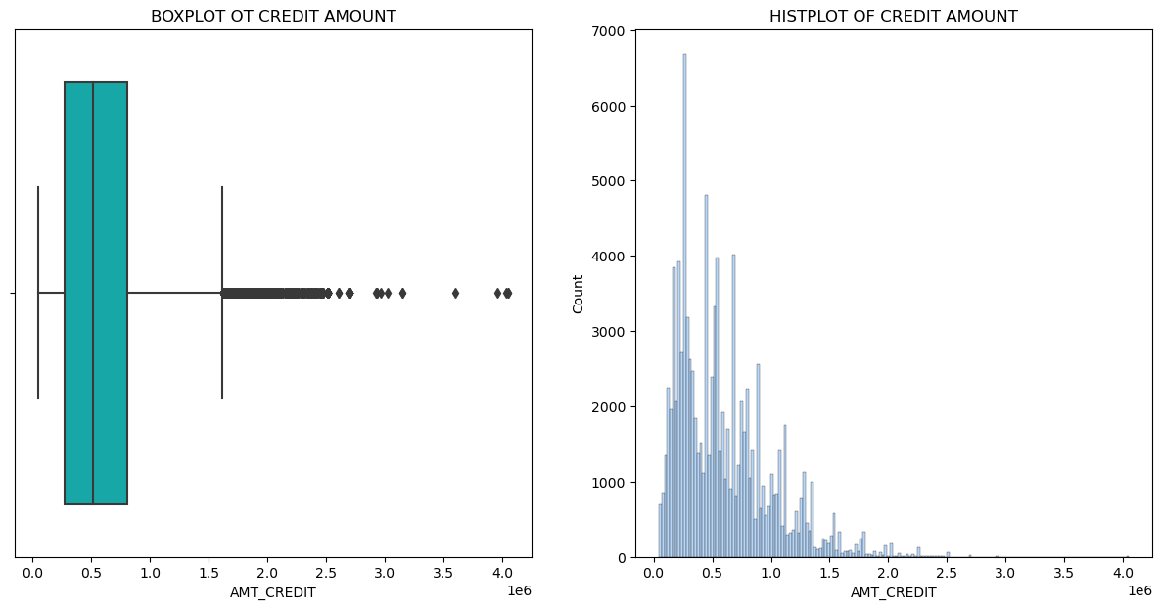
UNIVARIATE ANALYSIS OF NUMERICAL COLUMN
Interpretation---
The data for credit amount is positively skewed , and majority of people taken credit uptil 8 lakhs .
There are some outliers , which show some large amount of credit has also been given to some people, on what basis it has been given we need to find out further.

Slide 8
CONCLUSION FROM UNIVARIATE ANALYSIS ---
There are less number of revolving loans as compared to cash loans.
More number females i.e. 65% than males 35% .
On the basis of income type , working type are in majority then commercial associate, and pensioners and state govt.
Unemployed, student , businessman, maternity leave are very nominal .
Laborers are maximum in numbers , then sales, core staff, managers and drivers.
People from IT staff, HR staff, secretaries, reality agents are the least.
Mostly people have secondary education at 71%., then higher education at 24 %
People with academic education and lower education is very least in number.
The data for credit amount is positively skewed , and majority of people taken credit up-till 8 lakhs .
There are some outliers in credit amount , which show some large amount of credit has also been given to some people, on what basis it has been given we need to find out further.

Slide 9
BIVARIATE AND MULTIVARIATE ANALYSIS
For bivariate and multivariate analysis, dividing the credit amount into groups
l1= credit up to 5 lakhs
l2= credit from 5 lakhs - 10lakhs
l3= credit from 10lakhs - 20lakhs
l4= credit from 20 and above
Filtering the data for different credit bands and will analyse for income type, education , occupation, possession of car and house and documents submitted at the time of loan application.
Desired result-
To get customers , who default, don't default and have less probability to default i.e. 50:50

Slide 10
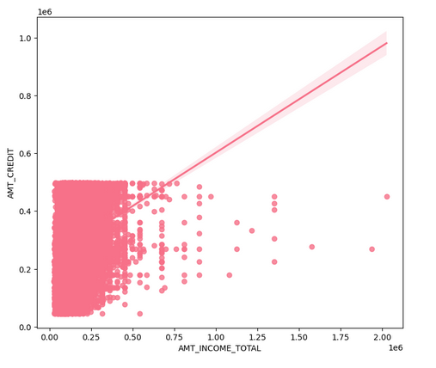
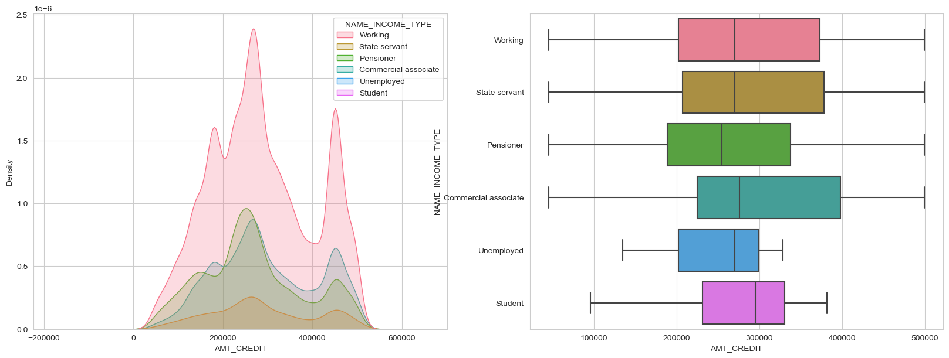
CREDIT UPTO 5 LAKHS – 48563 Customers
INTERPRETATION---
There is good relationship between the credit amount and income , with increase in income , credit also grows.
On the basis of type of income the credit kde plot is having a normal distribution where most people have taken credit of 2-4 lakhs , majority of people belong to working and pensioner type, commercial associate.

Slide 11
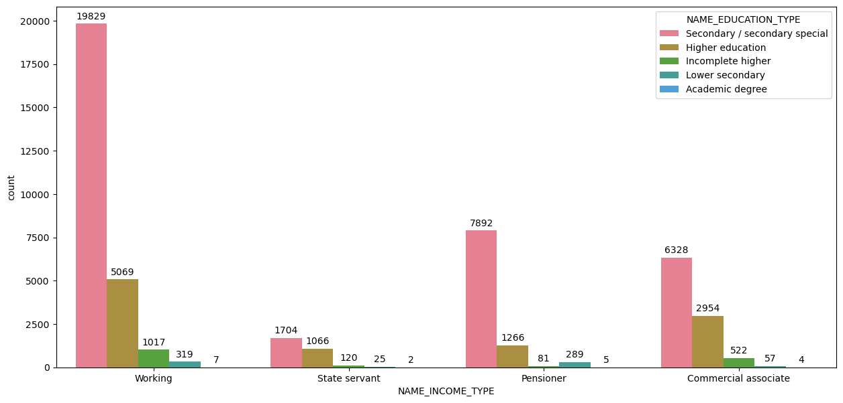
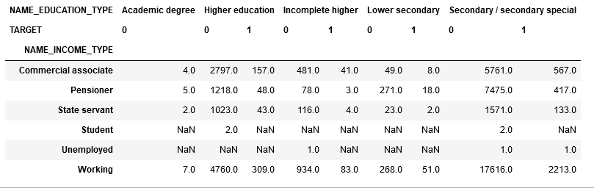
Interpretations--
Mostly people have working , pensioner and commercial associate.
On the basis of type of income the people with secondary education and higher education are more compared to others.
From the table below –
People with academic degree are not likely to default for credit up-to 5 lakhs and very few people have taken credit for this band .
Majority of people have secondary education and their probability to default is highest for each income type.
People with Higher education or incomplete higher education for all income groups are less likely to default .

Slide 12
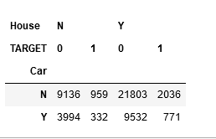
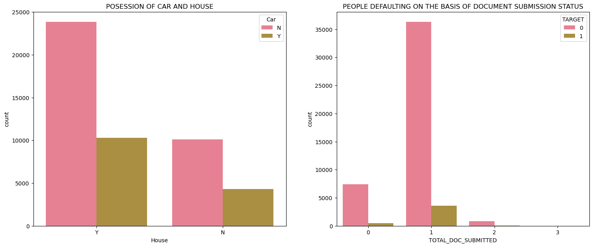
Interpretation--
People who doesn’t owns a house and don’t have a car are more likely to default.
People who have a car and a house are least likely to default.
People who have a car but don’t have a house are less likely to default.
People who don’t have a car but have a house are also less likely to default but they are more in number.
Majority of people have submitted a single document for getting credit , some of them are defaulters.
People who have submitted 2 documents have not defaulted.

Slide 13
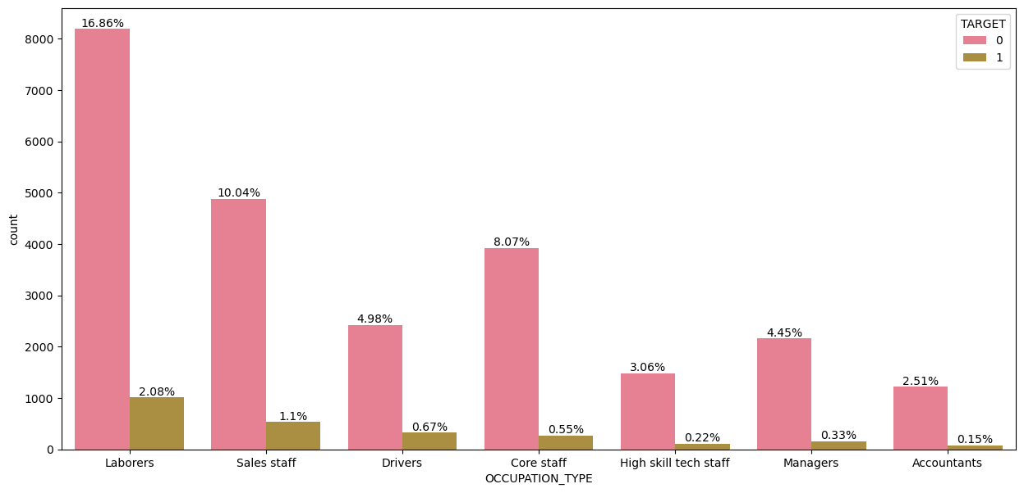
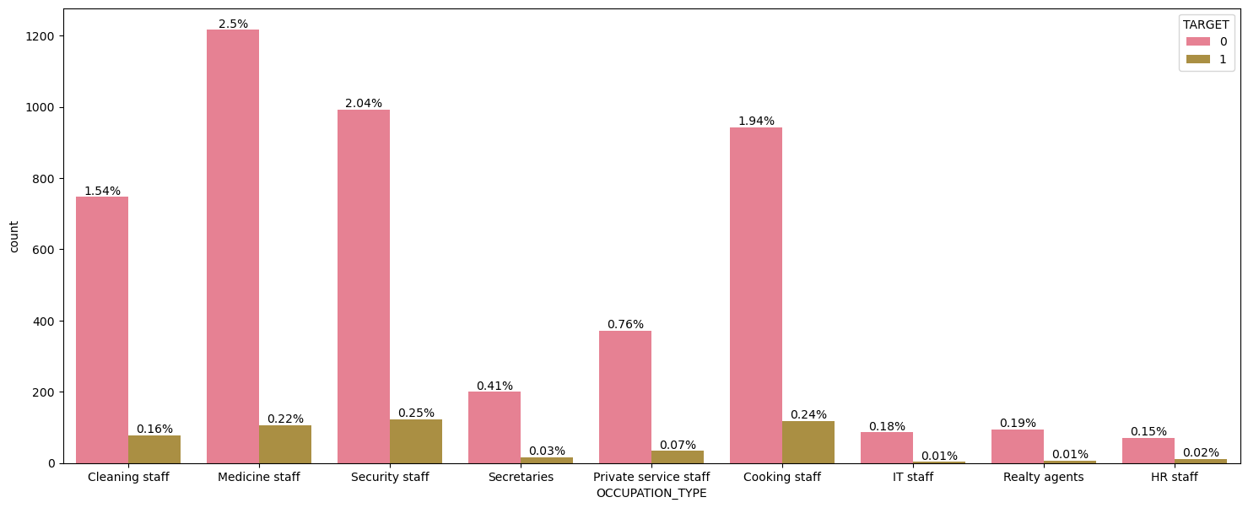
Interpretation---
Majority of people have occupation as labourers, sales, drivers, core staff, high tech skills , managers and accountants.
Majority of defaulters for credit up-to 5 lakhs are laborers, sales, drivers, core staff.
People belonging to other occupations are less probable to default.
People belonging to IT staff, HR staff , secretaries, realty agents have not defaulted .

Slide 14
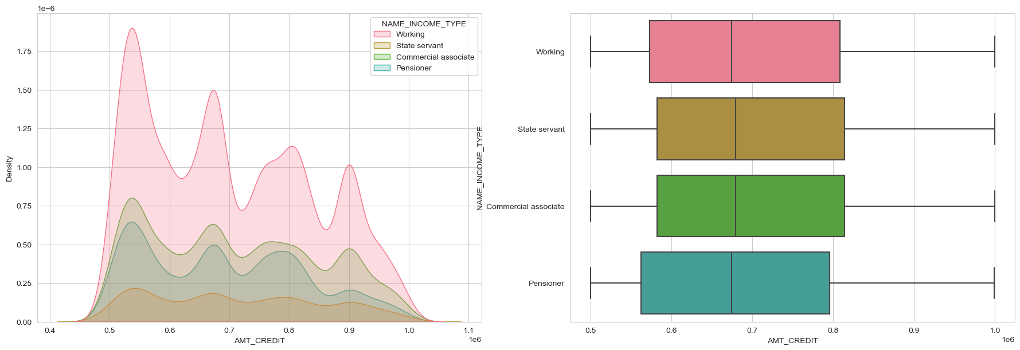
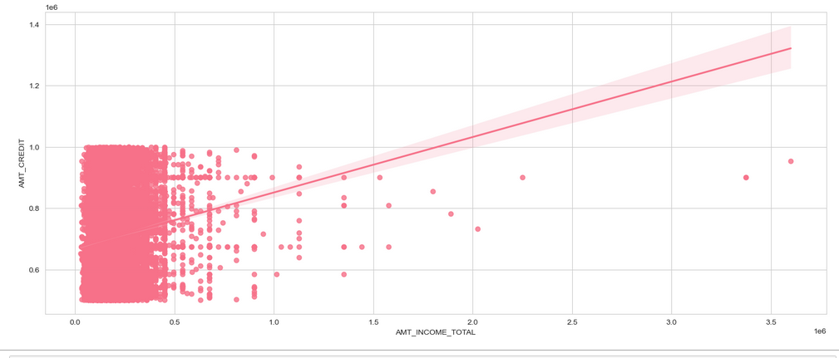
CREDIT UPTO 5 LAKHS TO 10 LAKHS—35153 Customers
Interpretation---
The kde plot for credit amount is positively skewed for credit between 5 to 10 lakhs.
The data is spreaded more and has several peaks at 5.5, 6.8, 8.0,9.0
People belonging to working income type is the highest and pensioner is the least .
Relationship between credit and income is directly proportional .
Majority of people have income less than 50,000 .

Slide 15
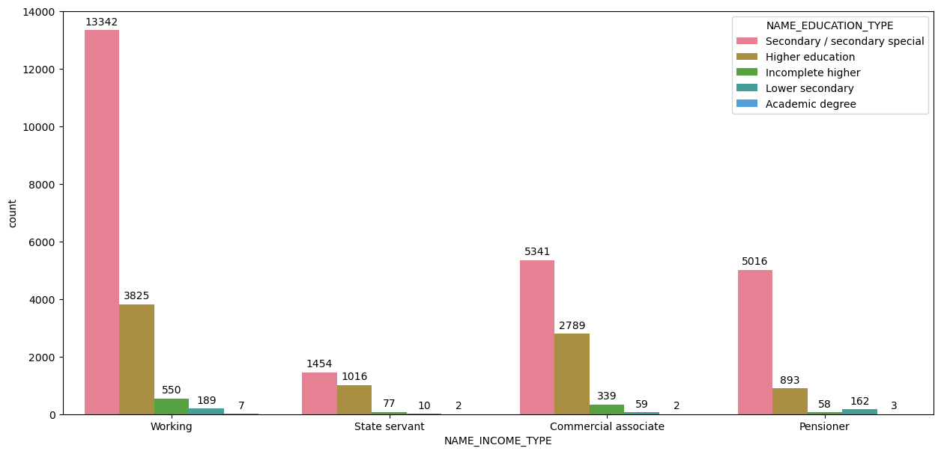
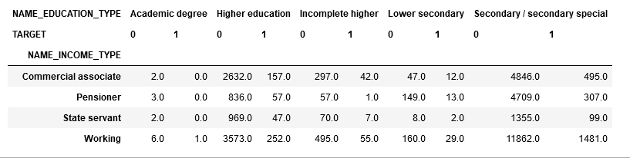
Interpretation---
People whose income type is working and has education as secondary education is the highest for credit band.
Very less number of people have academic degree and none of them are defaulters.
People who have higher education or incomplete education and belong to pensioner and state servant type are very less defaulting
Commercial associate For each education type are defaulting more .
People whom are commercial associate and working with secondary education are more likely to default.

Slide 16
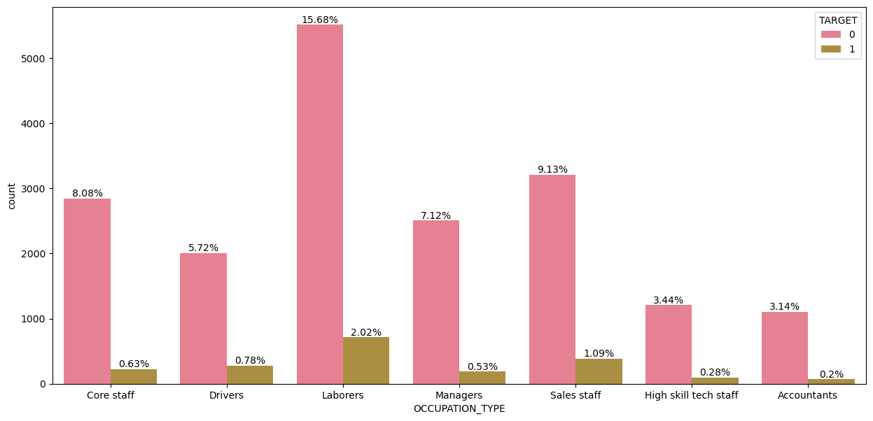
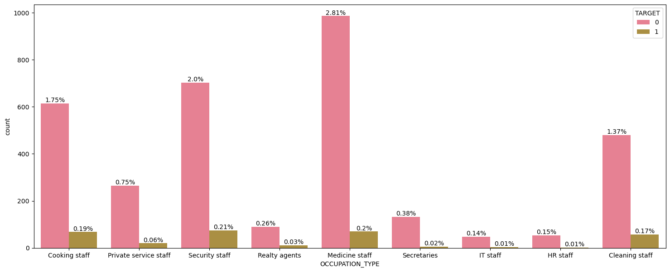
Interpretation---
Majority of people have occupation as labourers, sales, drivers, core staff, high tech skills , managers and accountants.
Majority of defaulters for credit from 5 to 10 lakhs are laborers, sales, drivers, core staff.
People belonging to other occupations are less probable to default.
People belonging to IT staff, HR staff , secretaries, realty agents have not defaulted .

Slide 17
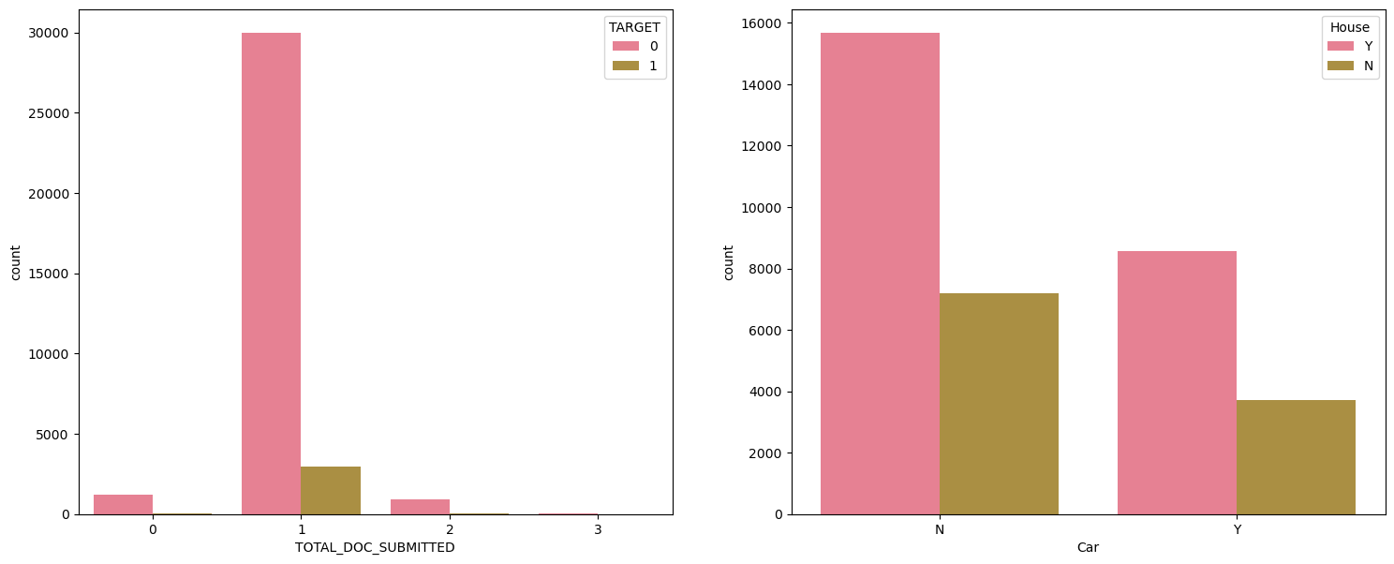
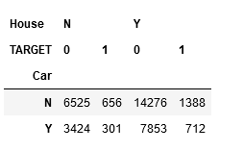
Interpretation--​
People who doesn’t owns a house and don’t have a car are more likely to default.​
People who have a car and a house are least likely to default.​
People who have a car but don’t have a house are less likely to default.​
People who don’t have a car but have a house are also less likely to default.​
Majority of people have submitted a single document for getting credit , some of them are defaulters.​
People who have submitted 2 documents have not defaulted.

Slide 18
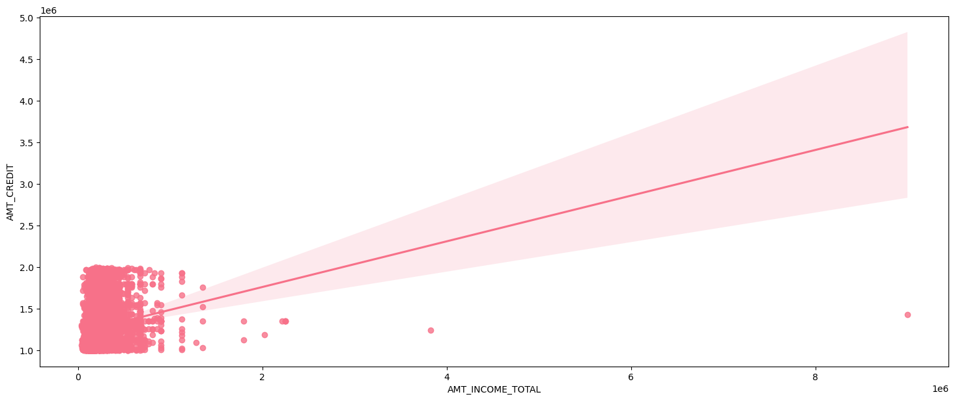
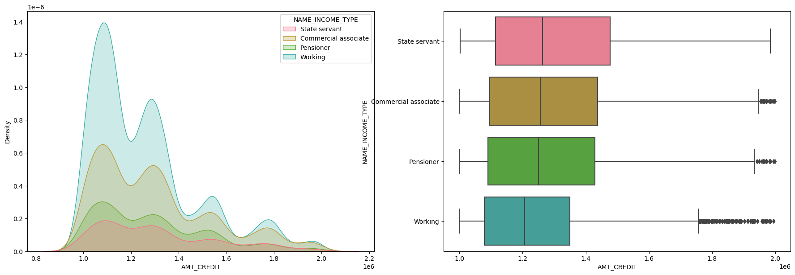
CREDIT AMOUNT BETWEEN 10 TO 20 LAKHs- 15673 Customers
Interpretation--
Majority of people have income till 1 lakh but they are getting credit between 10-20 lakhs.
People have taken credit more between 10-14 lakhs.
With increase in credit amount number of people decreases.
For working people credit is between 11-13 lakhs, for others credit is between 11-15 lakhs.
There are significant number of outliers for pensioners, working and commercial associate.

Slide 19
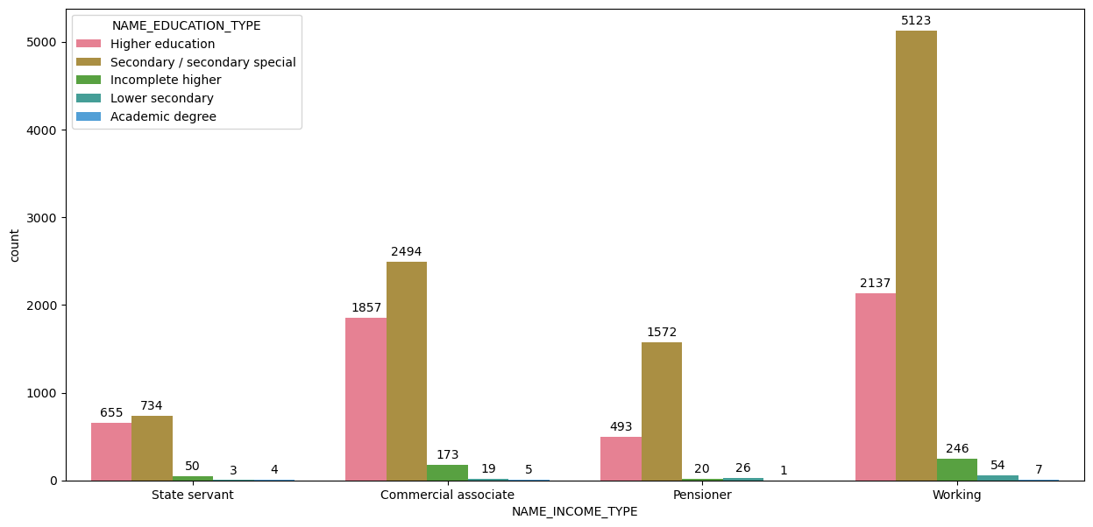
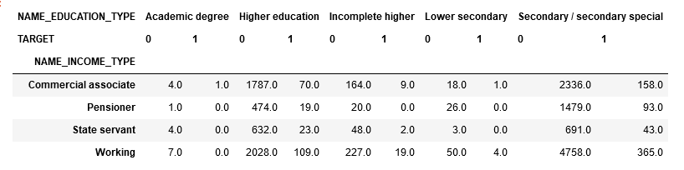
Interpretation--
People with academic degree and lower secondary education has no defaulters.
People with incomplete higher education has less probability to default .
People with secondary education and higher education have majority of defaulters.
Commercial associate and working type income are defaulting more .
Pensioners and state servant are defaulting less compared to others.

Slide 20
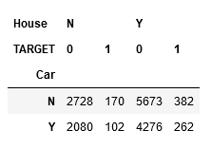
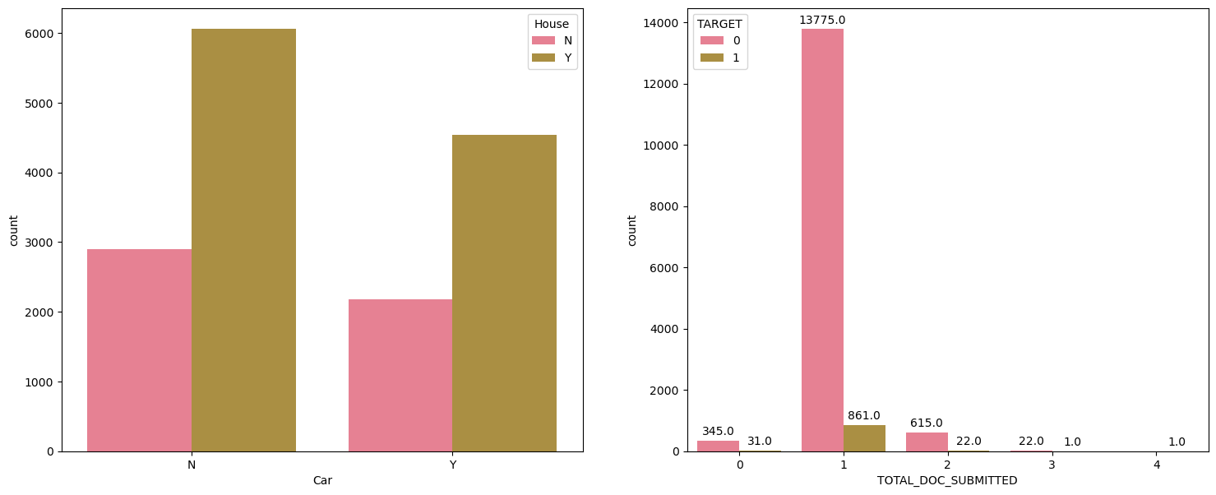
Interpretation--
With increase in credit amount , number of people defaulting is decreasing .
People who have a car and who don’t , people with car are less defaulting as compared to people without car.
People with house are more in number and defaulting more than people without house.
People whom have submitted single document have majority of defaulters.
People with 2 documents are small in numbers and less defaulting

Slide 21
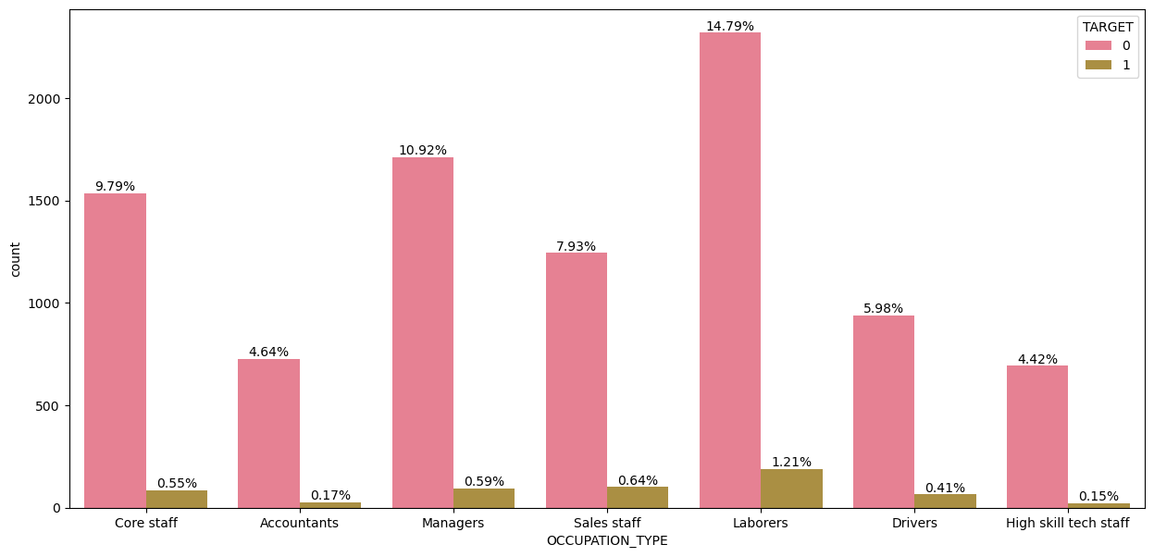
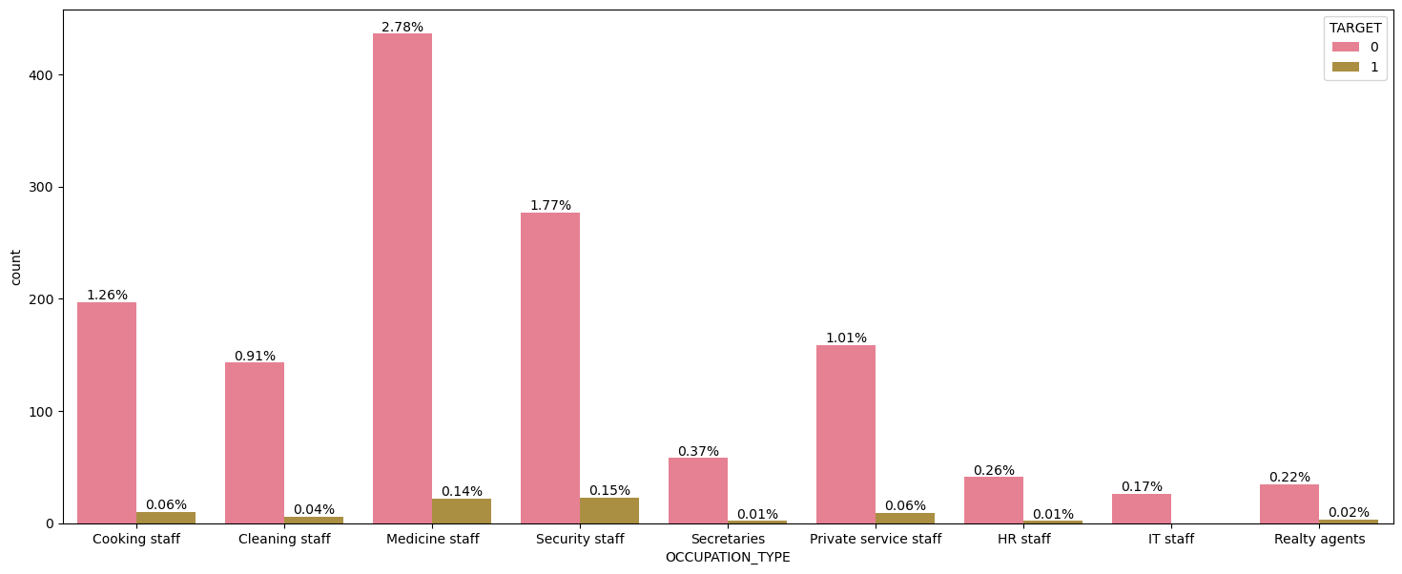
Interpretation---​
​
Majority of people have occupation as laborer, sales, drivers, core staff, high tech skills , managers and accountants.​
Majority of defaulters for credit from 10-20 lakhs are low-skill labors, realty agents, security staff, sales, laborers, drivers, core staff and managers.
People belonging to other occupations like accountants, secretaries, high skill tech staff are less probable to default. ​
People belonging to IT staff have not defaulted .

Slide 22
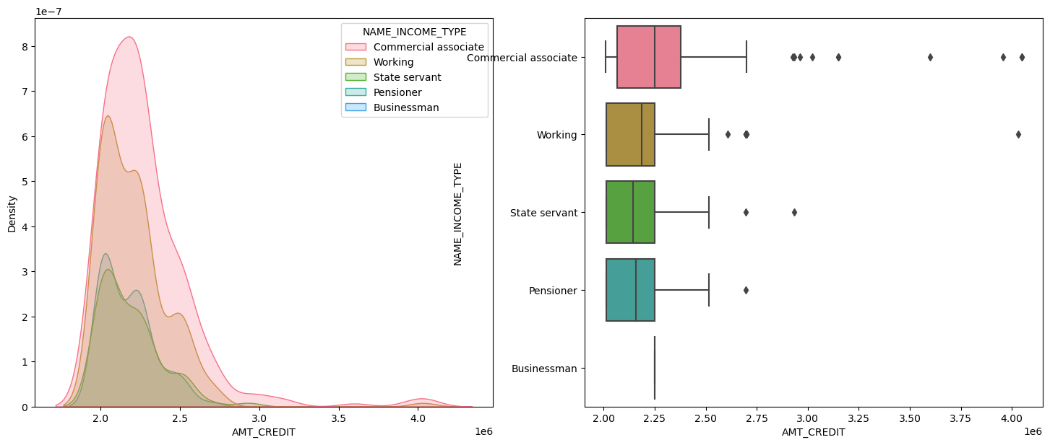
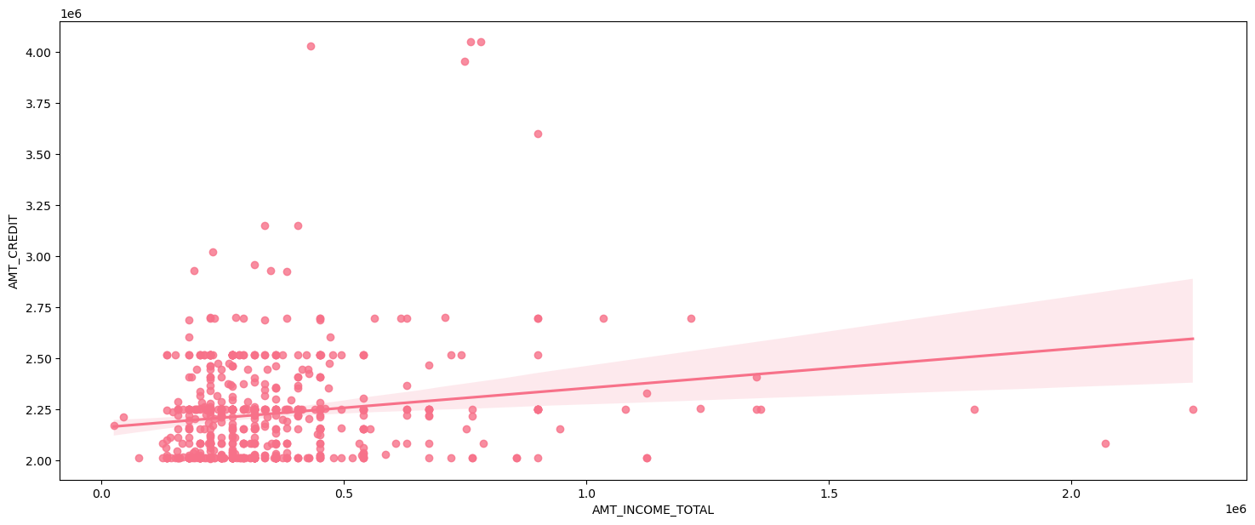
CREDIT LIMIT GREATER THAN 20 LAKHS –614 Customers
Interpretation--
Majority of people have income till 1 lakh but they are getting credit more than 20 lakhs.
People have taken credit more between 20-25 lakhs.
There are significant number of outliers for pensioners, working and commercial associate.
Commercial associate have taken very high amount of credit .
Working, pensioner, state servant have taken loans between 20-22.5 lakhs mostly.
Higher amount of loans are given to people with 50K to 1lakh income.

Slide 23
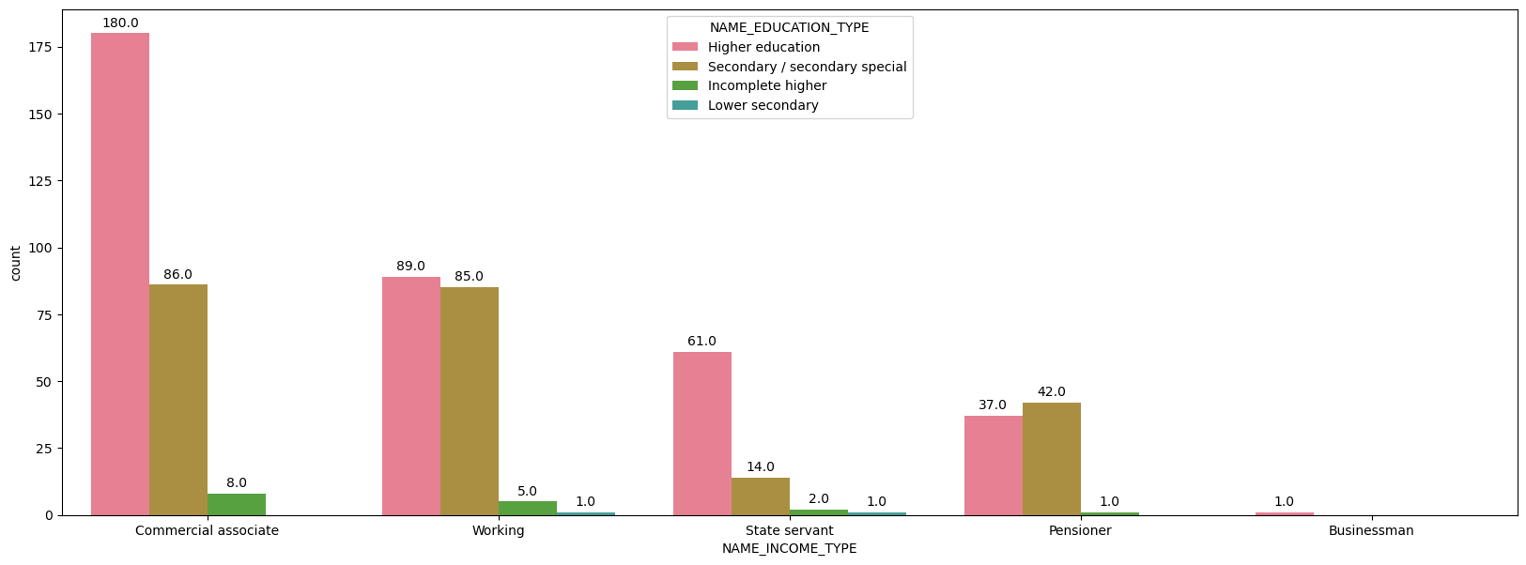
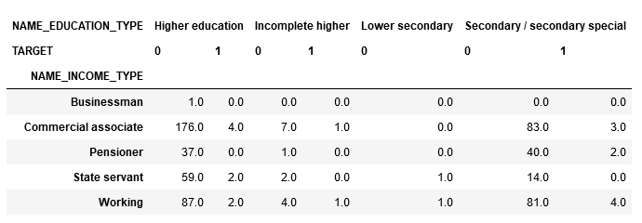
Interpretation--
People with incomplete higher and lower secondary education are no defaulters.
Pensioners with higher education and stater servant with secondary education are also not defaulting.
People with higher education and secondary education and working as commercial associate are more likely to default.

Slide 24
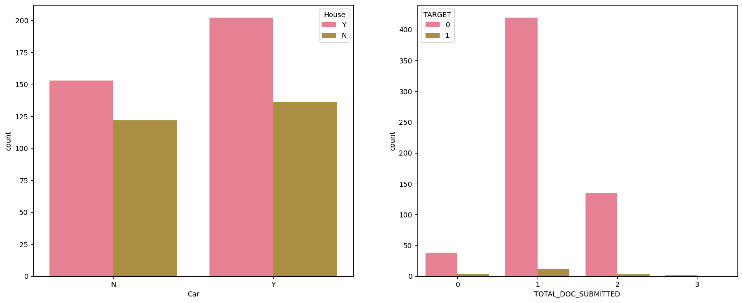
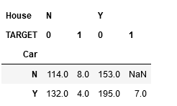
Interpretation--
People who have a car and who don’t have a house are less defaulting .
People with house only don’t default .
People who don’t have both are defaulting more as compared to who have both.
People whom have submitted single document have majority of defaulters.
People with 2 documents for large credit amount are more in numbers and less defaulting .

Slide 25
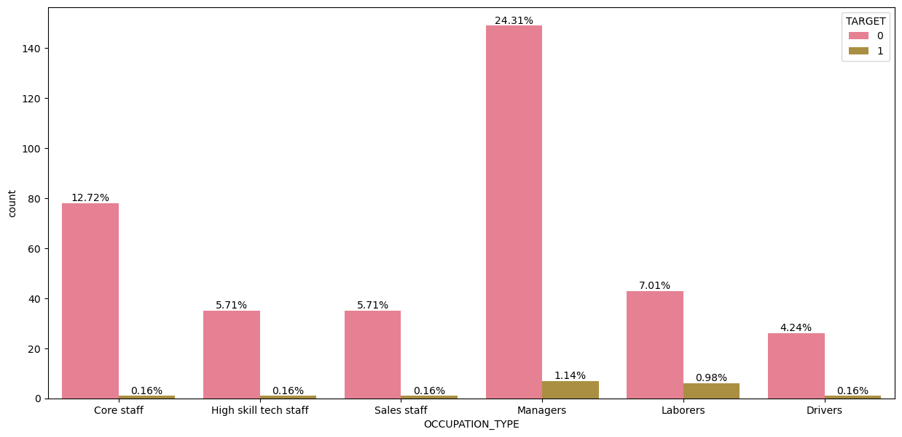
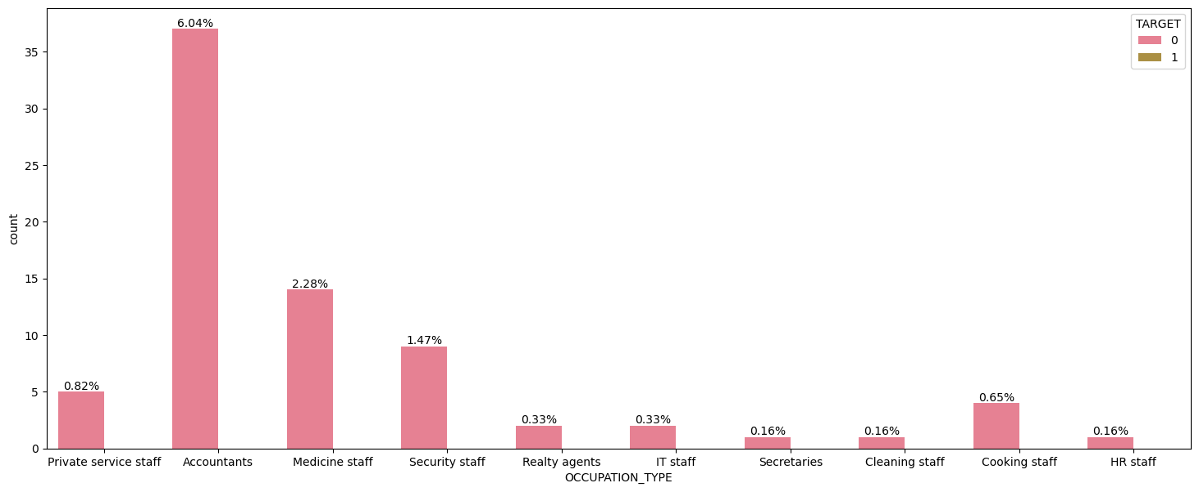
Interpretation---​
​
Majority of defaulters for credit more than 20 lakhs are laborers, and managers.
People belonging to other occupations like sales, high skill tech, core staff are less probable to default. ​
People belonging to IT staff , accountants, medicine, hr staff etc have not defaulted for large amount loans .

Slide 26
Credit limit | Non Defaulters | Defaulters | 50:50 or less probable to default
Up-to 5 lakhs | People with academic degree People who have submitted 2 documents. IT staff, HR staff , secretaries, realty agents have not defaulted . | People with secondary education People who doesn’t owns a house and don’t have a car are more likely to default. People who don’t have a car but have a house people have submitted a single document for getting credit Occupation-- laborers, sales, drivers, core staff, accountant | People with Higher education or incomplete higher education People who have a car and a house People who have a car but don’t have a house. Cleaning, medicine, cooking, secretary staff.
5-10 lakhs | People whom have academic degree . IT staff, HR staff , secretaries, realty agents . People who have submitted 2 documents have not defaulted | Commercial associate For each education type are defaulting more . Occupation- laborers, sales, drivers, core staff. Education- secondary education and higher education People who doesn’t owns a house and don’t have a car. people have submitted a single document for getting credit | People who have higher education or incomplete education and pensioner and state servant type are very less defaulting.

Slide 27
Credit limit | Non Defaulters | Defaulters | 50:50 or less probable to default
10-20 lakhs | People with academic degree and lower secondary education has no defaulters. People belonging to IT staff have not defaulted . | People with secondary education and higher education have majority of defaulters People who doesn’t owns a house and don’t have a car are more likely to default. People who don’t have a car but have a house people have submitted a single document for getting credit Occupation-- low-skill labors, realty agents, security staff, sales, laborers, drivers, core staff and managers. Commercial associate and working type income . | People with incomplete higher education People who have a car and a house People who have a car but don’t have a house. Accountants, secretaries, high skill tech staff. People with 2 documents are small in numbers and less defaulting Pensioners and state servant are defaulting less compared to others.
20 lakhs and above | Incomplete higher and lower secondary education Pensioners with higher education and stater servant with secondary education are also not defaulting. People who have a car and who don’t have a house are less defaulting . People with house only . IT staff , accountants, medicine, HR staff, secretaries etc. | Commercial associate For each education type are defaulting more . Occupation- laborers, and managers. Education- secondary education and higher education People who don’t have both are defaulting more as compared to who have both. people have submitted a single document for getting credit | People with higher education and secondary education and working as commercial associate are more likely to default. People with 2 documents for large credit amount are more in numbers and less defaulting . sales, high skill tech, core staff

Slide 28
THANKYOU ANY QUESTIONS ARE WELCOME

